Slide 1
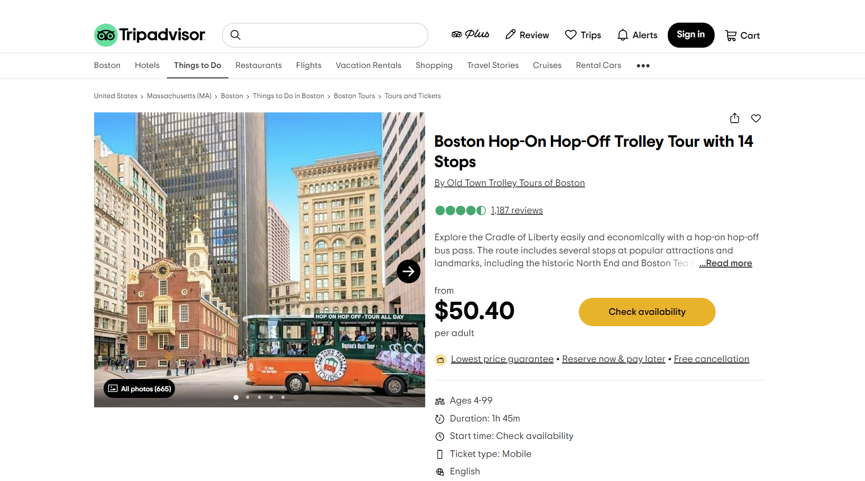
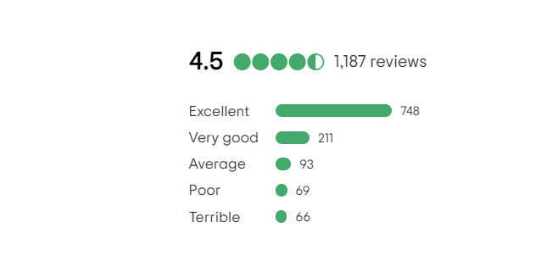
TripAdvisor
Web Crawling
Group 14
Group 14: Tra Mai Hoang
Vamsee Priyaa
Shreya Chanda
Soumya Parihar

Slide 2
/TABLE OF CONTENTS
/01
/ Introduction
/02
/ Web Crawling + Database
/03
Analysis
/04
/Conclusion
Group 14
Web Crawling Definition
Tripadvisor website
Kinds of crawling data + Used databases
Descriptive
Visualization
Regression
Sentimental
Text Mining
Techniques achievements
INDEX.HTML

Slide 3

/01
/Introduction
INDEX.HTML

Slide 4
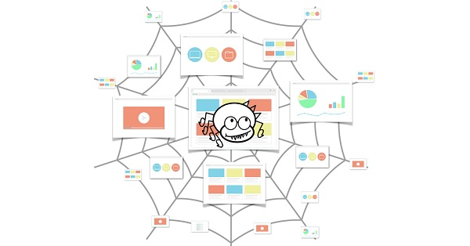
What is Web Crawling ?
•A web crawler, crawler is a computer program that searches and indexes website content and other information on the internet. These programs or bots, are most commonly use to generate search engine index entries.
•Web crawlers browse web pages in a systematic manner to learn what each page on a website is about, so that this information can be indexed, updated, and retrieved when a user performs a search query. While updating their own web content, other websites use web crawling bots.

Slide 5
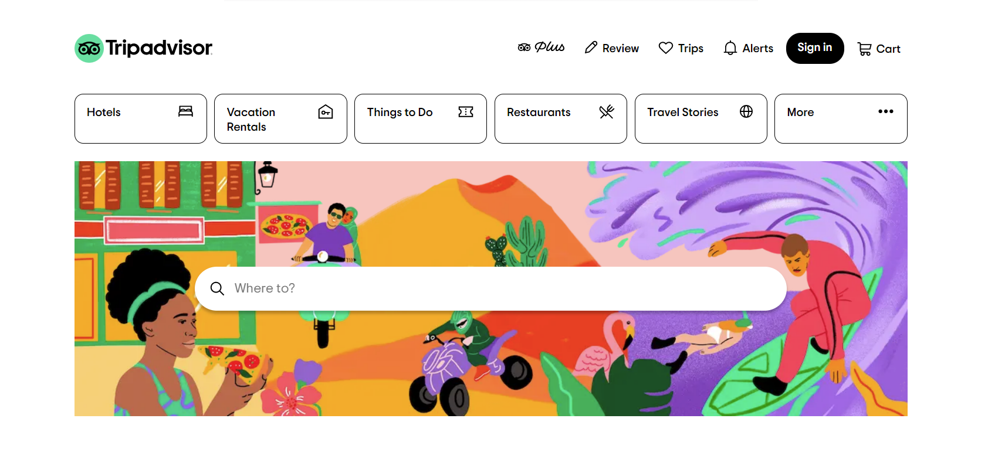
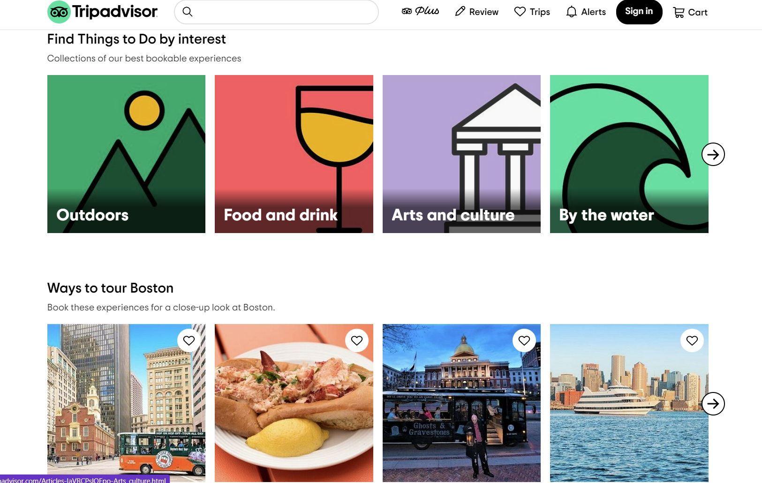
TRIPADVISOR
Tripadvisor, Inc. is an American online travel company that operates a website and mobile app with user-generated content and a comparison-shopping website. It also offers online hotel reservations and bookings for transportation, lodging, travel experiences, and restaurants

Slide 6
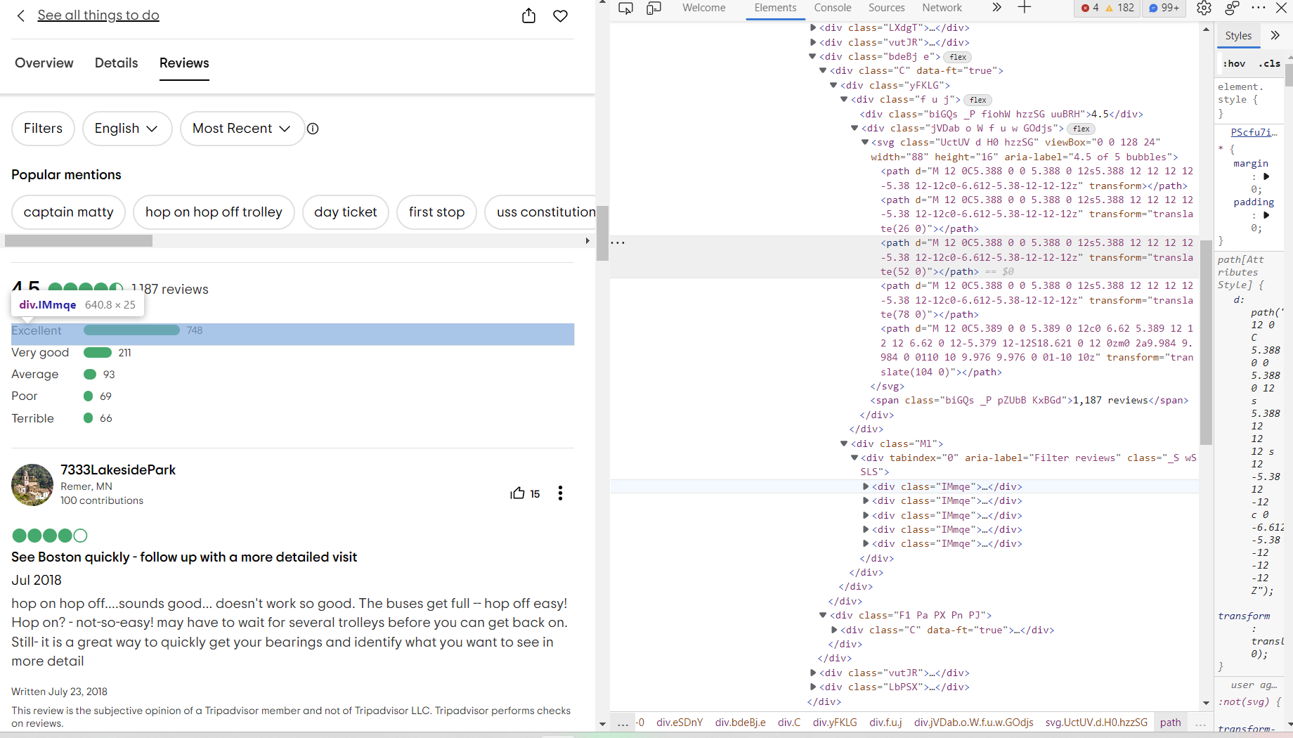
IDENTIFYING
•Going to the web sit and identifying the element to extract
•Identify the HTML elements and html tags associated with them.
Regex101 is an expression console to debug the expression in real-time

Slide 7
SUMMARIZE
Finding the ideal locations for our vacations is an intriguing aspect of our project.
We can see that 75% of customers have provided a 5-star rating, and only a small percentage (around 7%) have given a rating below that.
Help the target audiences comprehend the data ( between ratings vs contributions, connection between datas and messages and time period)
However, the average score indicates that there may be room for development. The majority of users appear to be content, according to sentiment analysis.
One can quickly locate recent and positive evaluations.

Slide 8
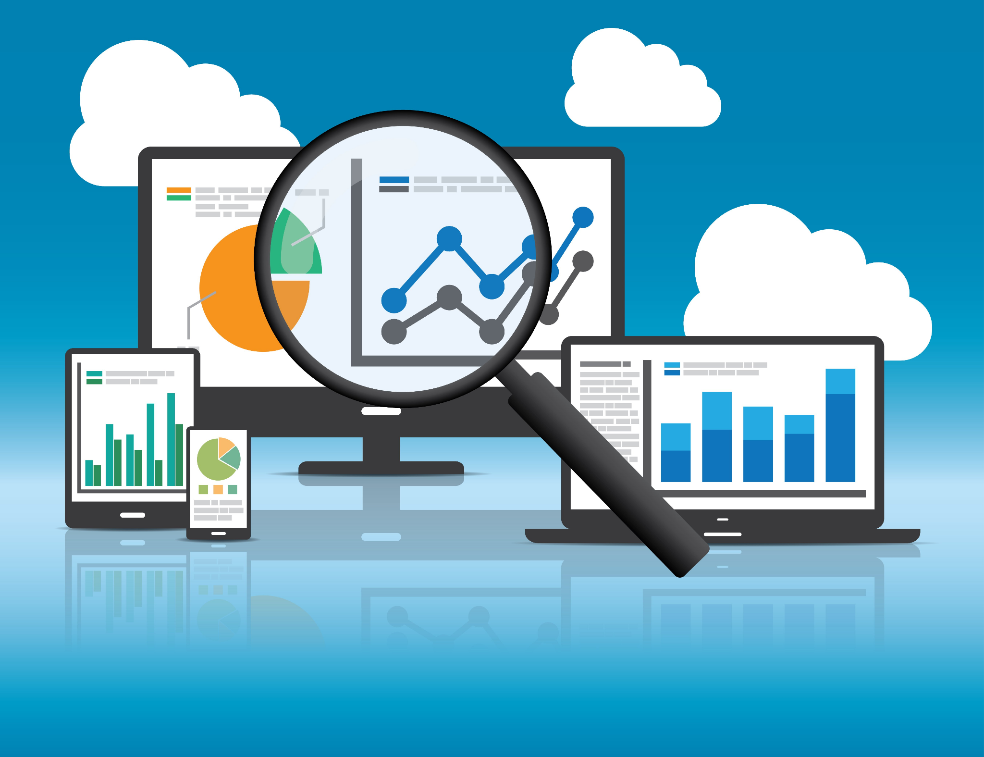
/02
/Web Crawling +
Database
INDEX.HTML

Slide 9
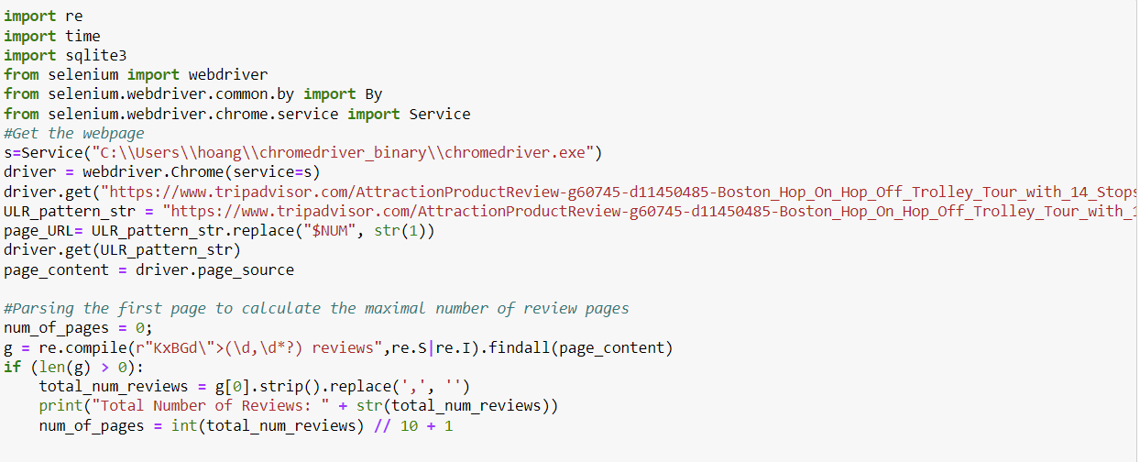
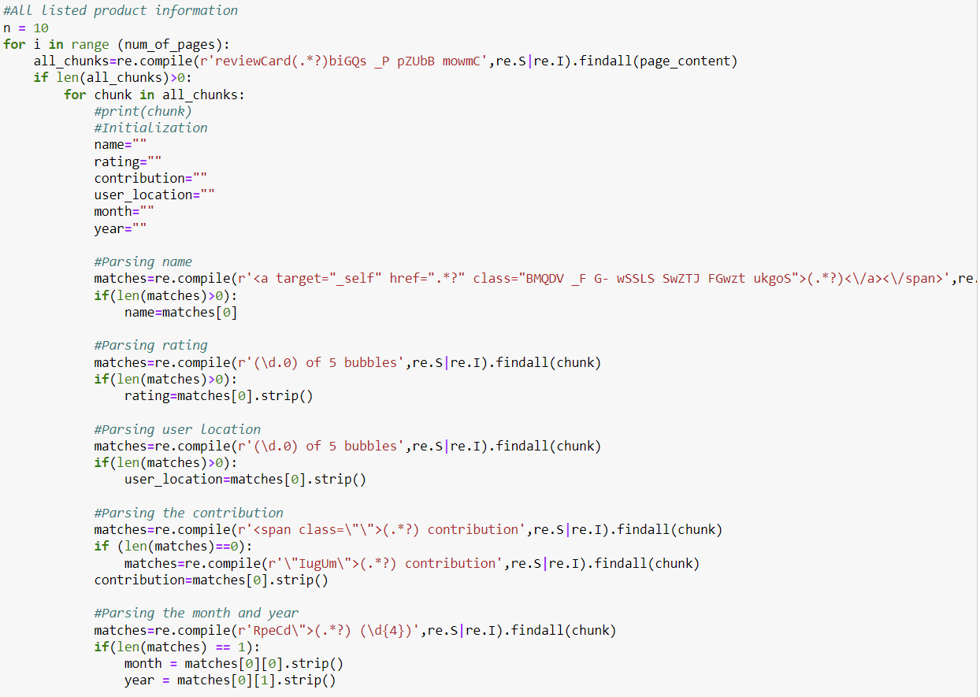
DATA CRAWLING
Types of Crawling Data
Reviewer Name
Rating
Contribution
Reviewer Location
Written Date
Written Year

Slide 10
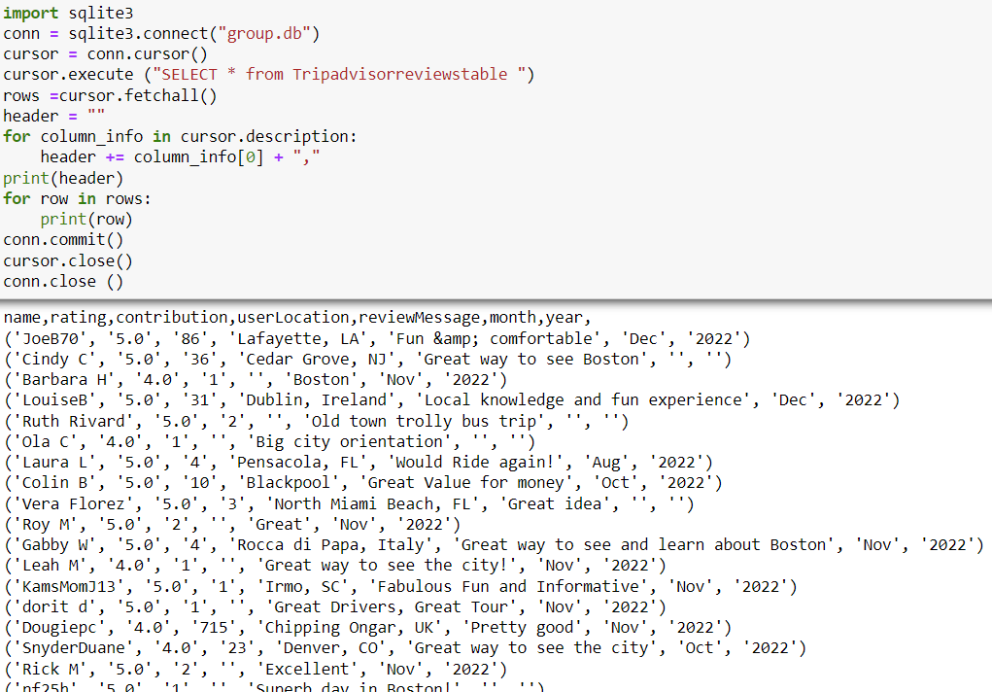
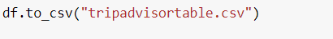
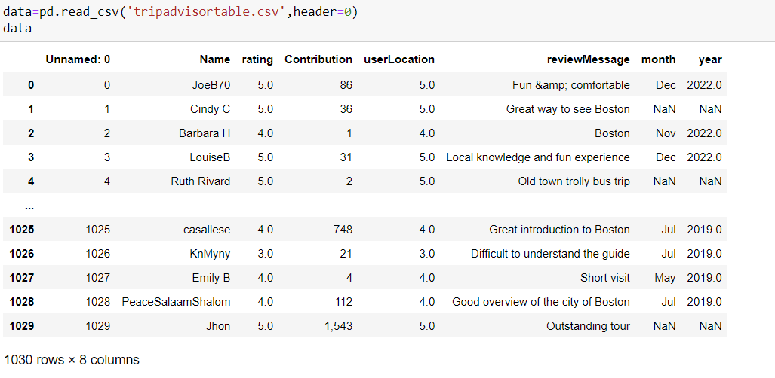
DATABASE

Slide 11
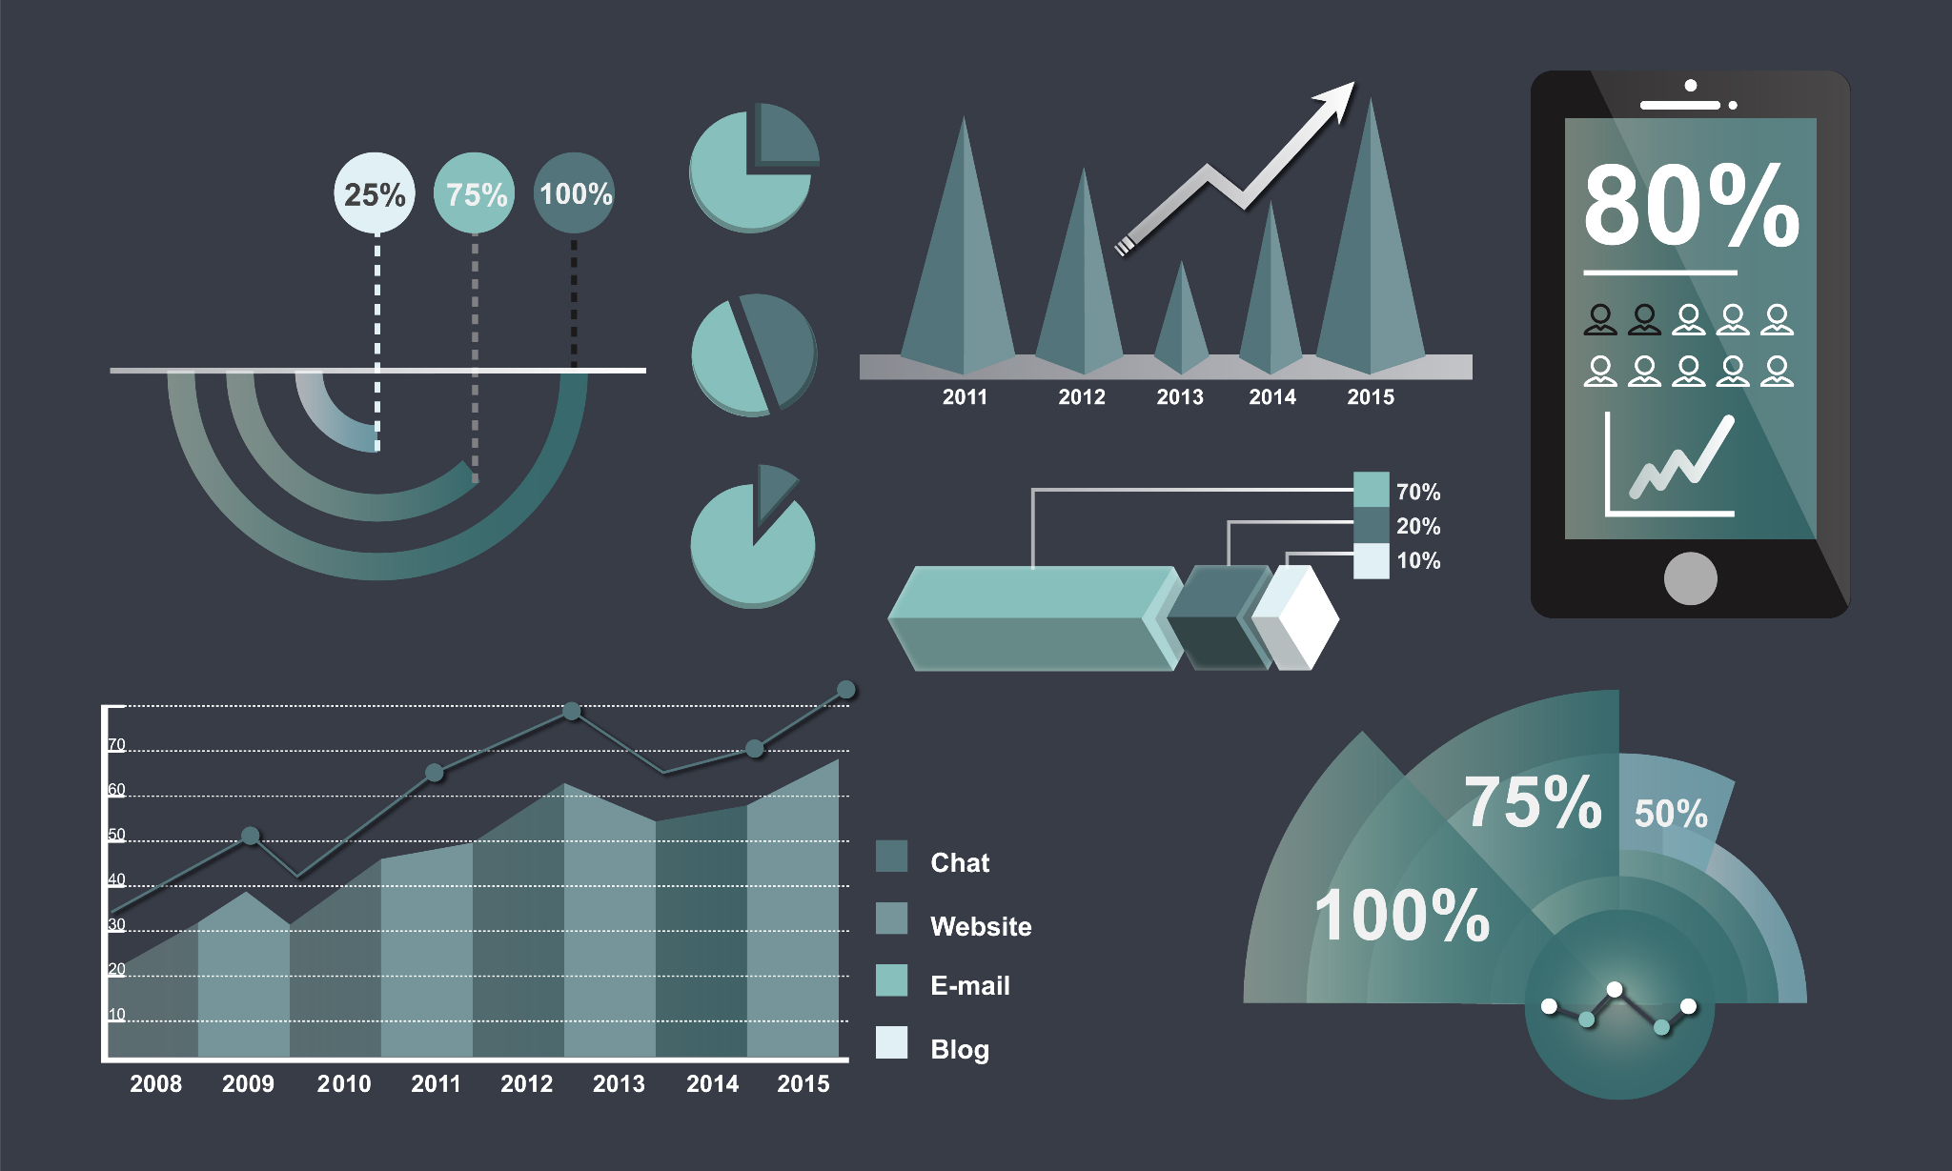
/03
/Analysis
YOUR LOGO HERE
INDEX.HTML

Slide 12
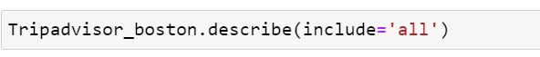
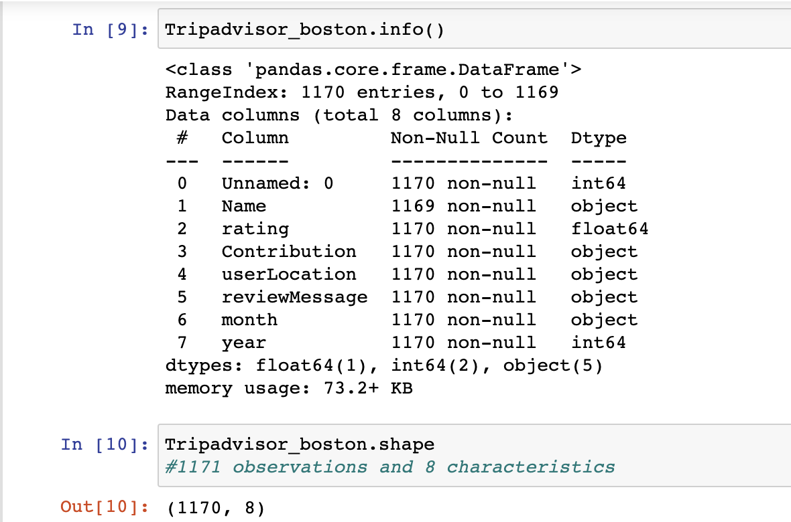
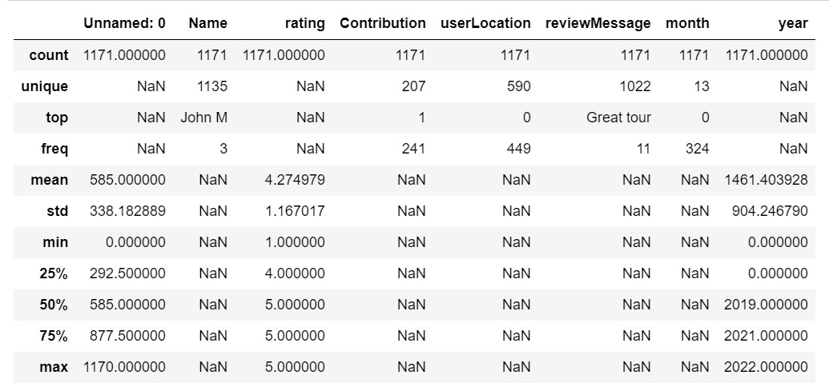
DESCRIPTIVE ANALYSIS

Slide 13
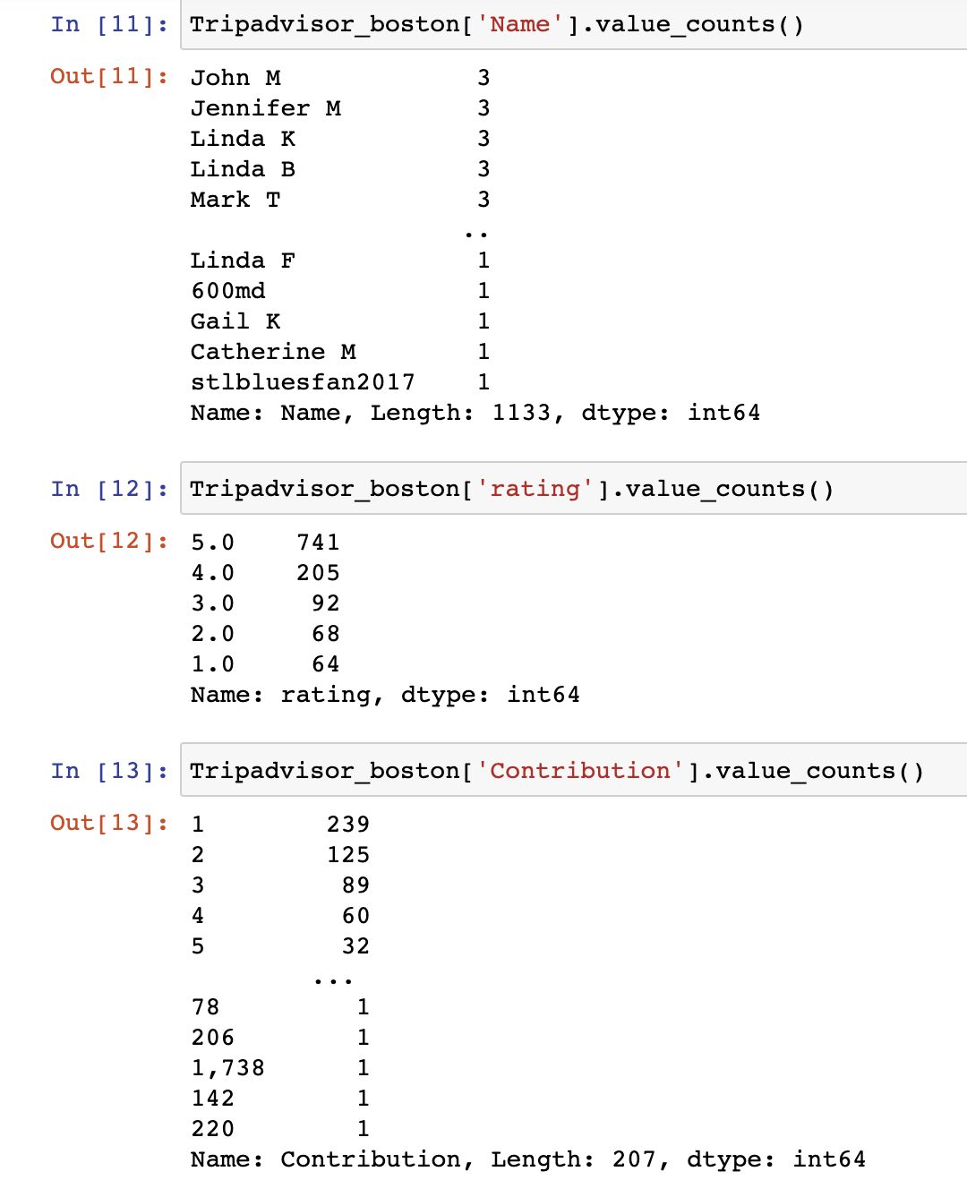
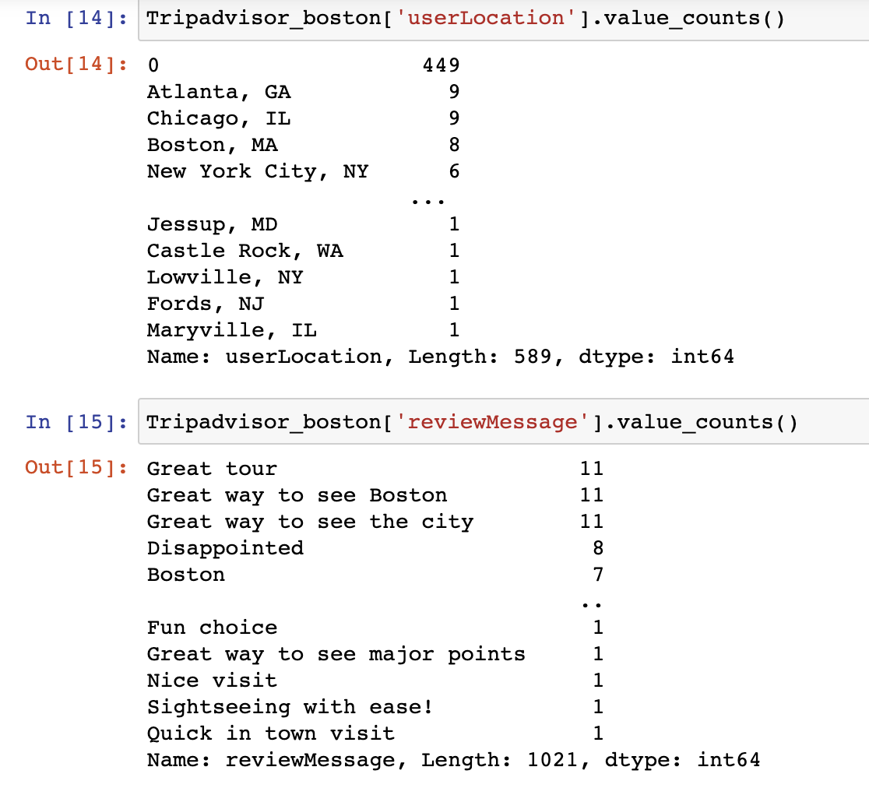
VALUE COUNTS OF THE VARIABLES
(

Slide 14
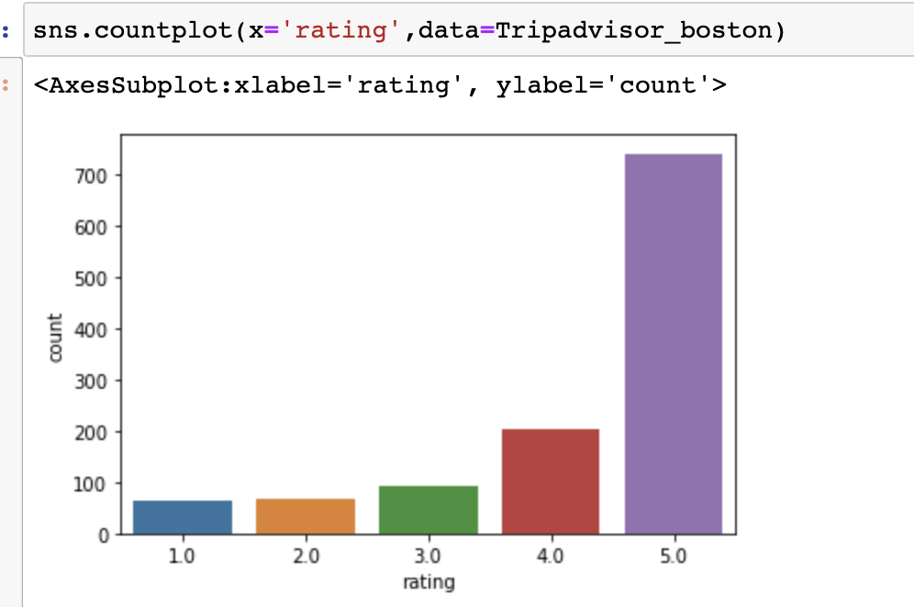
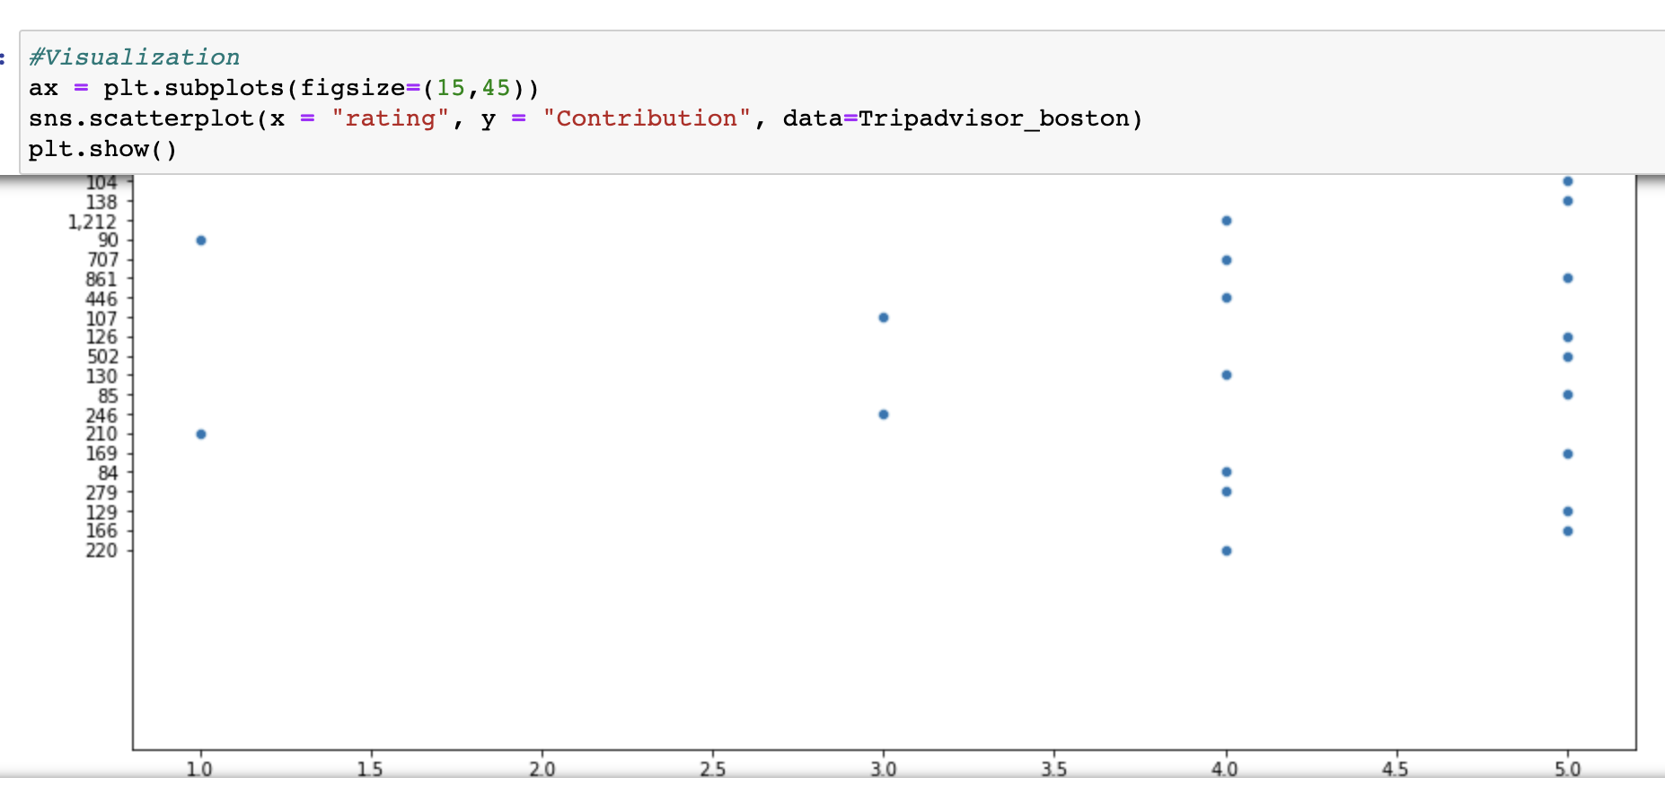
VISUALIZATION

Slide 15
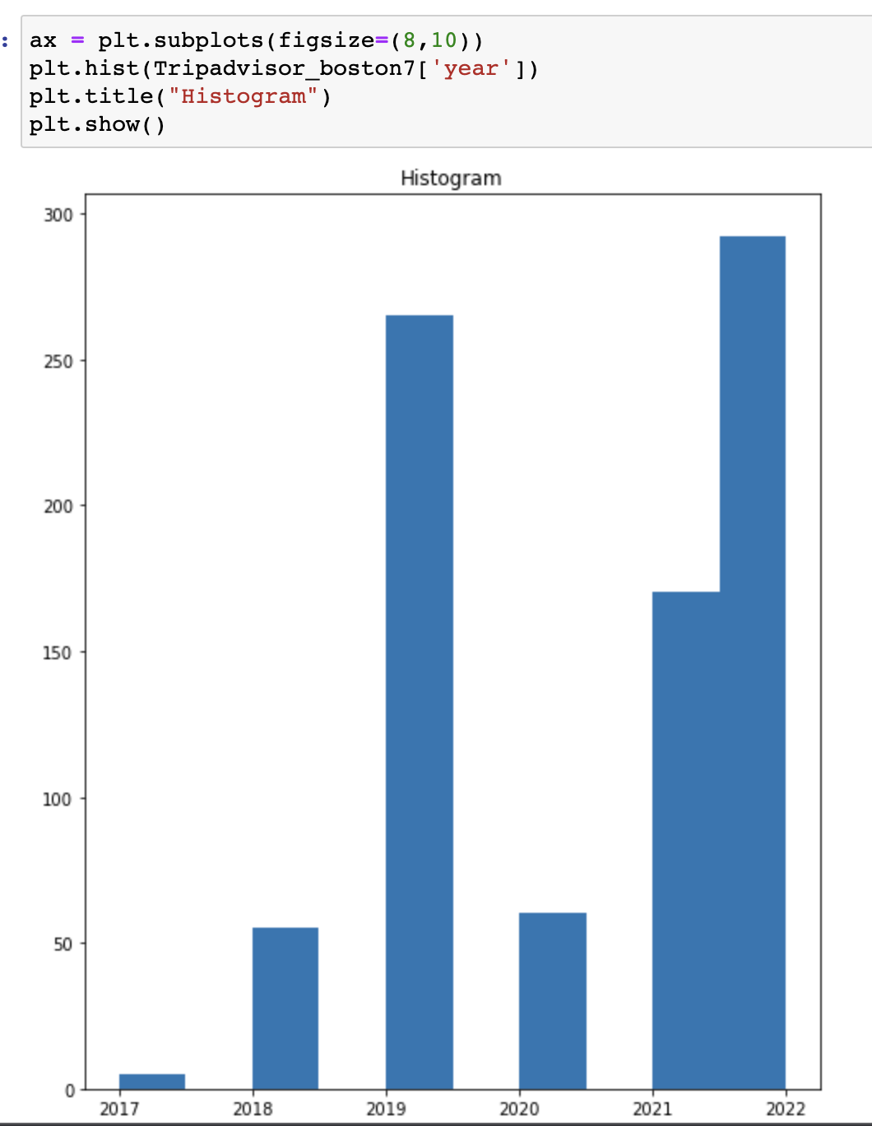
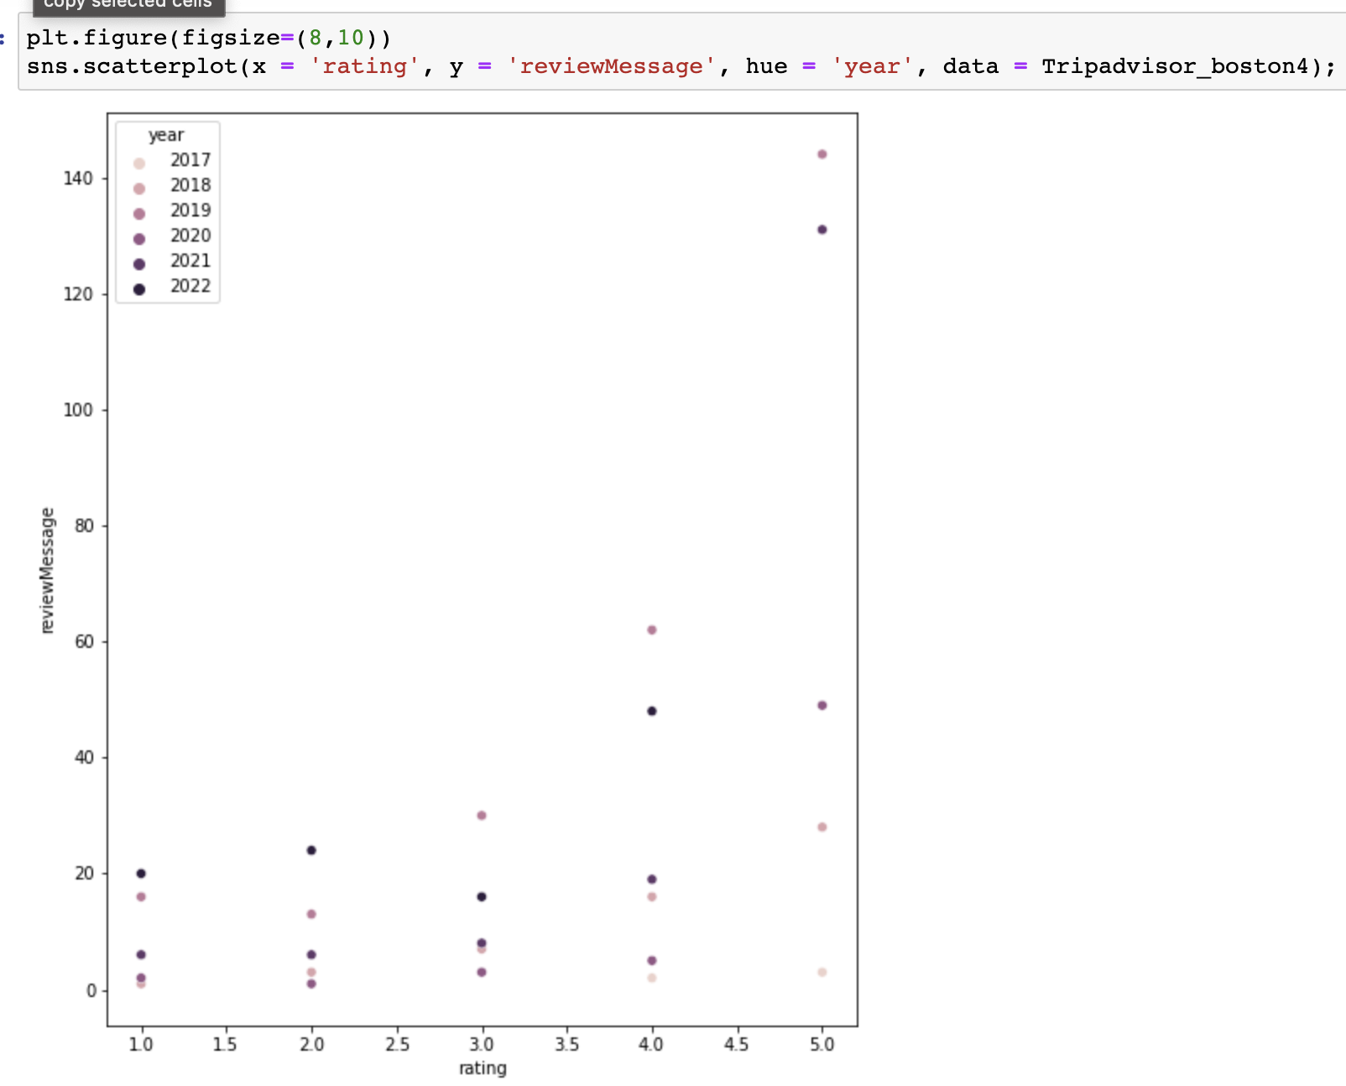
VISUALIZATION

Slide 16
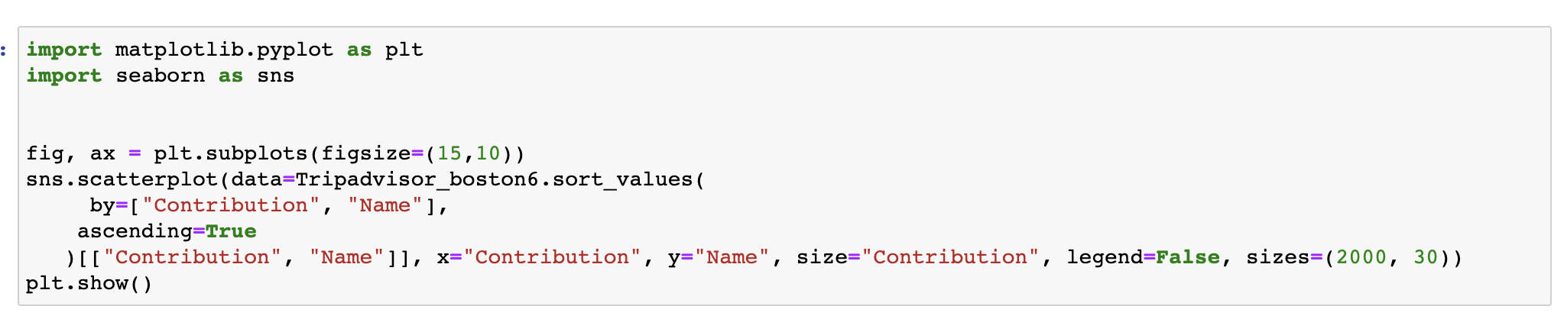
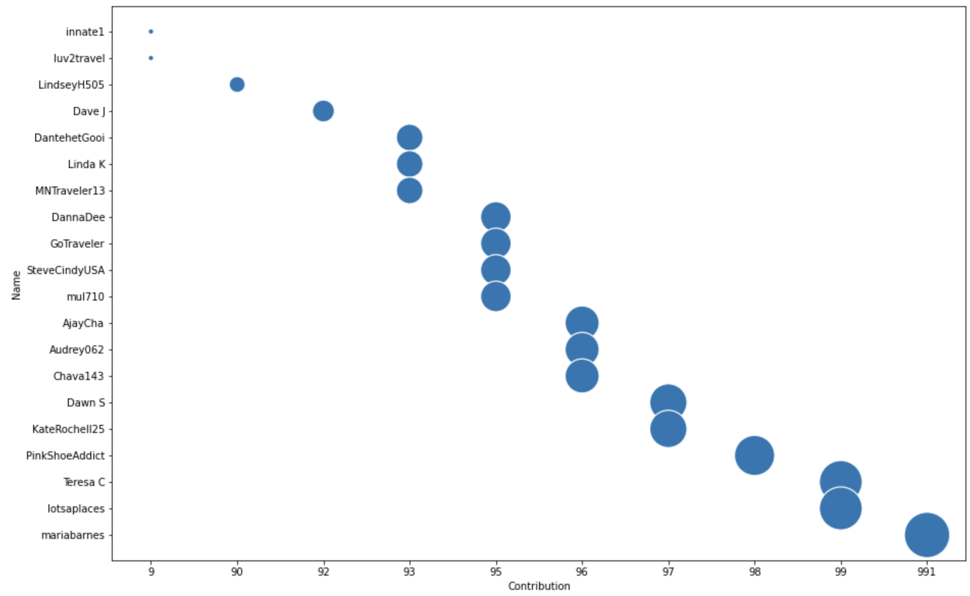
Bubble chart shows the relationship between first 20 customer and their contribution

Slide 17
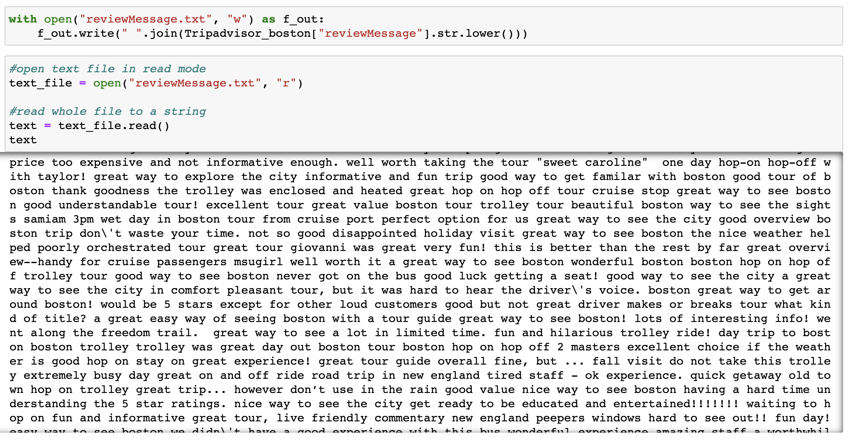
TEXT MINING ANALYSIS
The process of extracting meaningful
information from natural language
text is known as text mining.
The output shows the text divided
into tokens. Tokens are words, commas, and
punctuation marks.

Slide 18
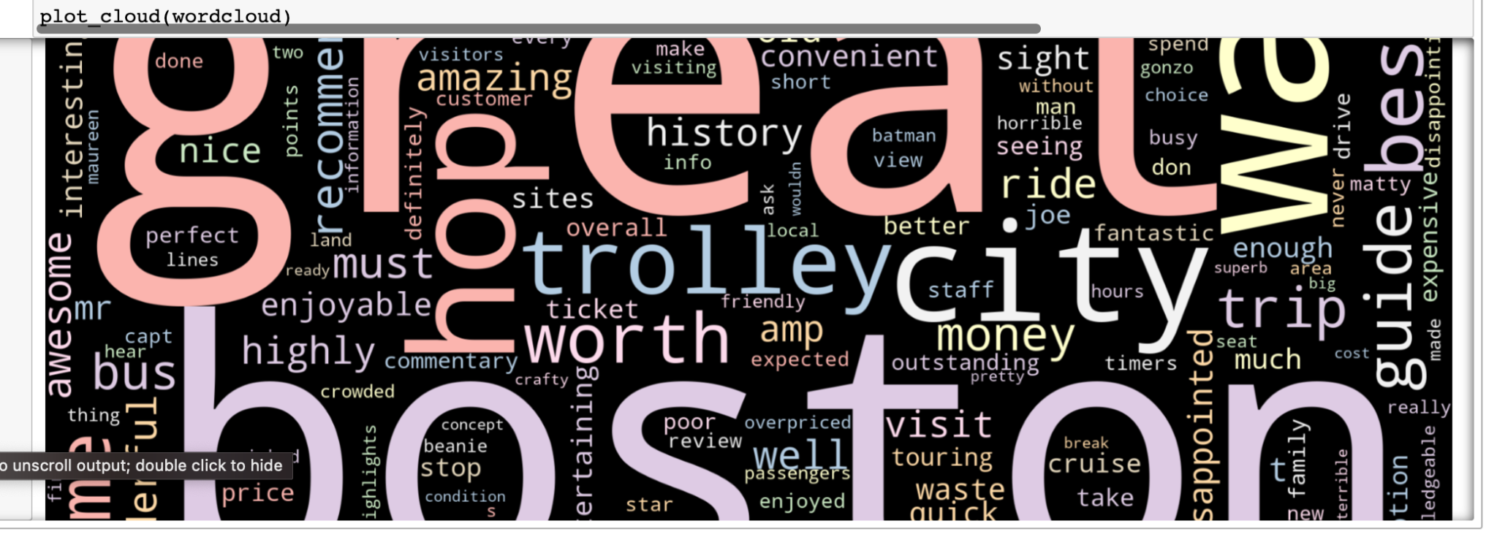
TEXT MINING ANALYSIS
The process of extracting meaningful
information from natural language
text is known as text mining.
These are the most frequent word
used in the Review.

Slide 19
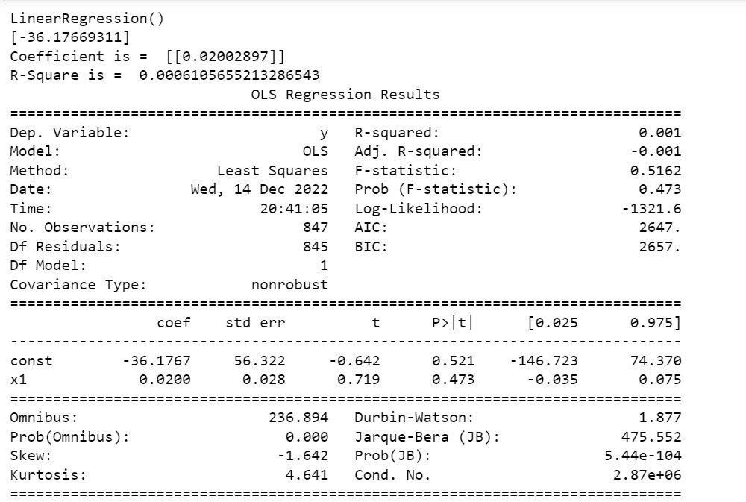
Regression Analysis

Slide 20
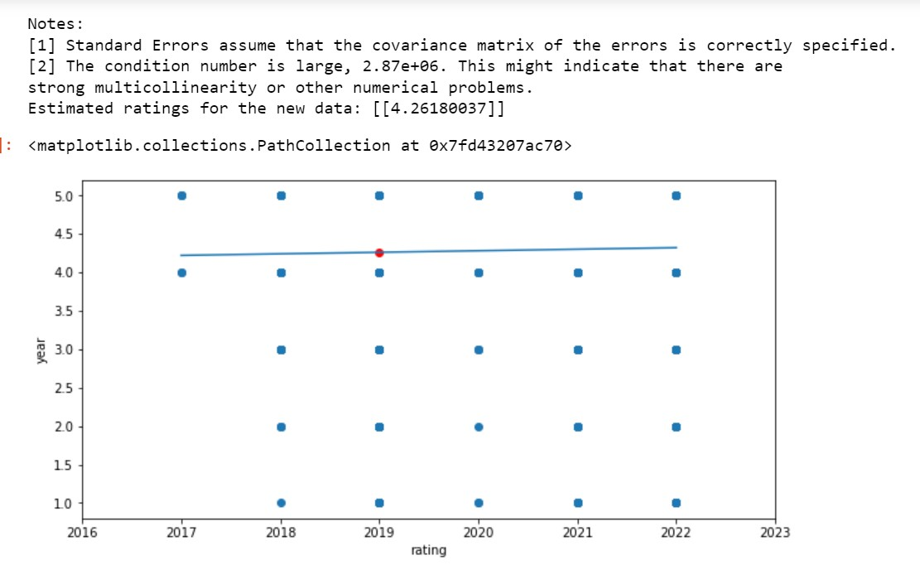
Regression Analysis

Slide 21
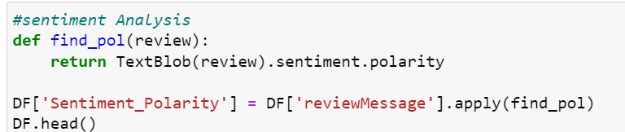
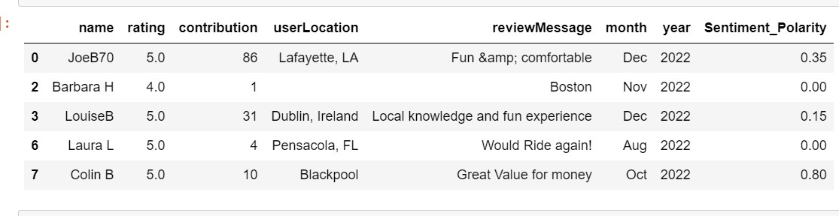
Sentiment Analysis
Sentiment analysis is a technique
for determining the underlying
sentiment in text.
We can now see a new column
called 'sentiment polarity' at
the right corner of
the data frame.

Slide 22
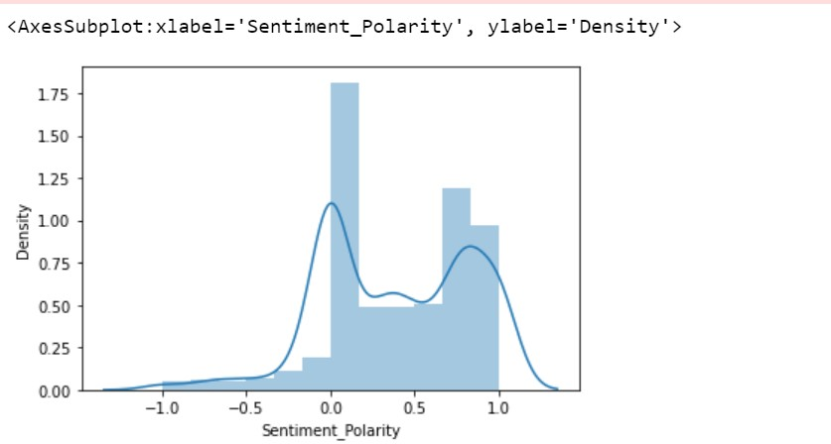
SENTIMENT ANALYSIS
Most of the Sentiment Polarity
lies between 0 to 1 which means
That the rewiew messages are
positive review

Slide 23
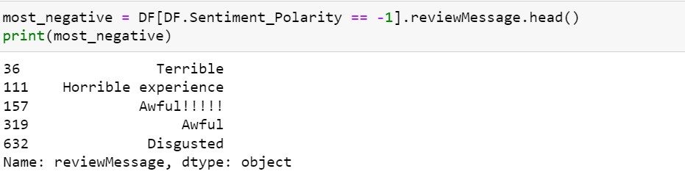
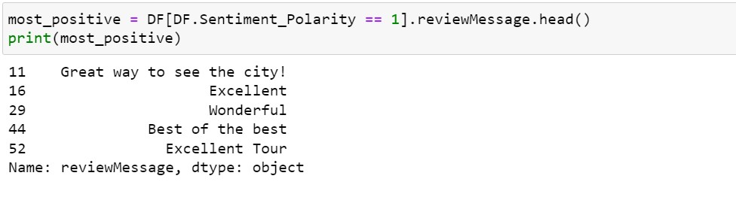
SENTIMENT ANALYSIS
Top 5 most negative and positive

Slide 24

/04
/Conclusion
YOUR LOGO HERE

Slide 25
Technical Achievements
Efficient web crawling (Main achievement we are proud of)
Python Coding: More self-assurance, definitely!
We ran descriptive and regression and listed all the finding
Visualizations: Could gain a lot of insights from uncooked data.
Text and Sentiment Analysis: Never imagined that just a few basic lines of coding, we could comprehend data, trends, and outliers with such ease.

Slide 26
References
Director, Yair Ida | Sales, et al. “Web Crawling vs Web Scraping.” Bright Data, 26 Oct. 2022, brightdata.com/blog/leadership/web-crawling-vs-web-scraping?kw=&cpn=17858767388&cam=aw_web_data-pmax-top_en___&utm_matchtype=&cq_.
Gal El Al | Director of Support, et al. “Python Web Scraping Guide - Learn How to Scrape with Python.” Bright Data, 1 Dec. 2022, brightdata.com/blog/how-tos/web-scraping-with-python?kw=&cpn=17858767388&cam=aw_web_data-pmax-top_en___&utm_matchtype=&cq_src=go.
Holtz, Yan. “Basic Bubble Plot with Matplotlib.” The Python Graph Gallery, www.python-graph-gallery.com/270-basic-bubble-plot.
Selvaraj, Natassha. “A Beginner's Guide to Sentiment Analysis with Python.” Medium, Towards Data Science, 12 Sept. 2020, towardsdatascience.com/a-beginners-guide-to-sentiment-analysis-in-python-95e354ea84f6.
Shah, Rahul. “Word Cloud in Python: How to Build Word Cloud in Python?” Analytics Vidhya, 2 Dec. 2022, www.analyticsvidhya.com/blog/2021/05/how-to-build-word-cloud-in-python/.

